Slide 1


Slide 2
Problem statement
Students hectic schedule makes it hard to for them to complete their school work and revision effectively and efficiently.

Slide 3

Allot
Allot is intelligent, efficient and a dynamic scheduler to boost time management for secondary students. It helps students be more productive and stay on task.
Language use: Java, Kotlin, PHP, C++

Slide 4
Rationale
15 year old students devote 9.4 hrs to do homework a week
This shows how time management is even more important effectively complete homework
80% of students reported that they switch between studying and technology.
This shows the importance to restrict access to unnecessary apps

Slide 5
Target Audience
Secondary school students
Increased amount of commitments, homework, academic
expectations, project work compared to primary school
Students become stressed and quality of work drops
Mobile phones distracting in their studies

Slide 6
Are you able to plan your after school activities with a packed schedule
Using their phones for leisure purposes
Do you have 9 or more hours of sleep everyday?
5
Yes
1
4
1
2
5
3
Section Subtitle
No
2
3
4
1 being the least and 5 being the most

Slide 7
Do you think having an app to efficiently plan out your work and ensure productivity after school will be useful?
Do you think you think a timeline that allows you to envision upcoming events will be useful?
1
1
2
5
2
5
3
4
3
4
1 being the least and 5 being the most

Slide 8





Dynamic scheduling
Reminders & Tools
Restrictions
An ever-changing algorithm
Ultimate convenience
Build self-discipline
The scheduling algorithm is internal module to constantly accommodate to change variables(dynamic). The workaround will forever be sustained by constants, fueled by data, such as the Rule of 52 and 17*
The goal of the scheduling algorithm is to boost productivity while keeping the user’s welfare in mind. It is also capable of thinking ahead, and work asynchronously.
Notifications will be sent out periodically by the app for users to be well-prepared.
Tools will be deployed based on subjects users are working on.
Restriction of access to distracting apps such as games and social media.
Exceptions will be apps to aid students with their education. This is to allow students to be on task and use the phone as a tool of education.
Dynamic scheduling
A backend that can adapt to change variables with smart workarounds derived from resource based algorithms.
Reminders and tools
Tools can be deployed based on the individual work subjects. Scheduled work will be notified beforehand, to allow users to be prepared.
Restrictions
Intelligent phone restriction, by only blocking apps that serves as distraction during worktimes.

Slide 9
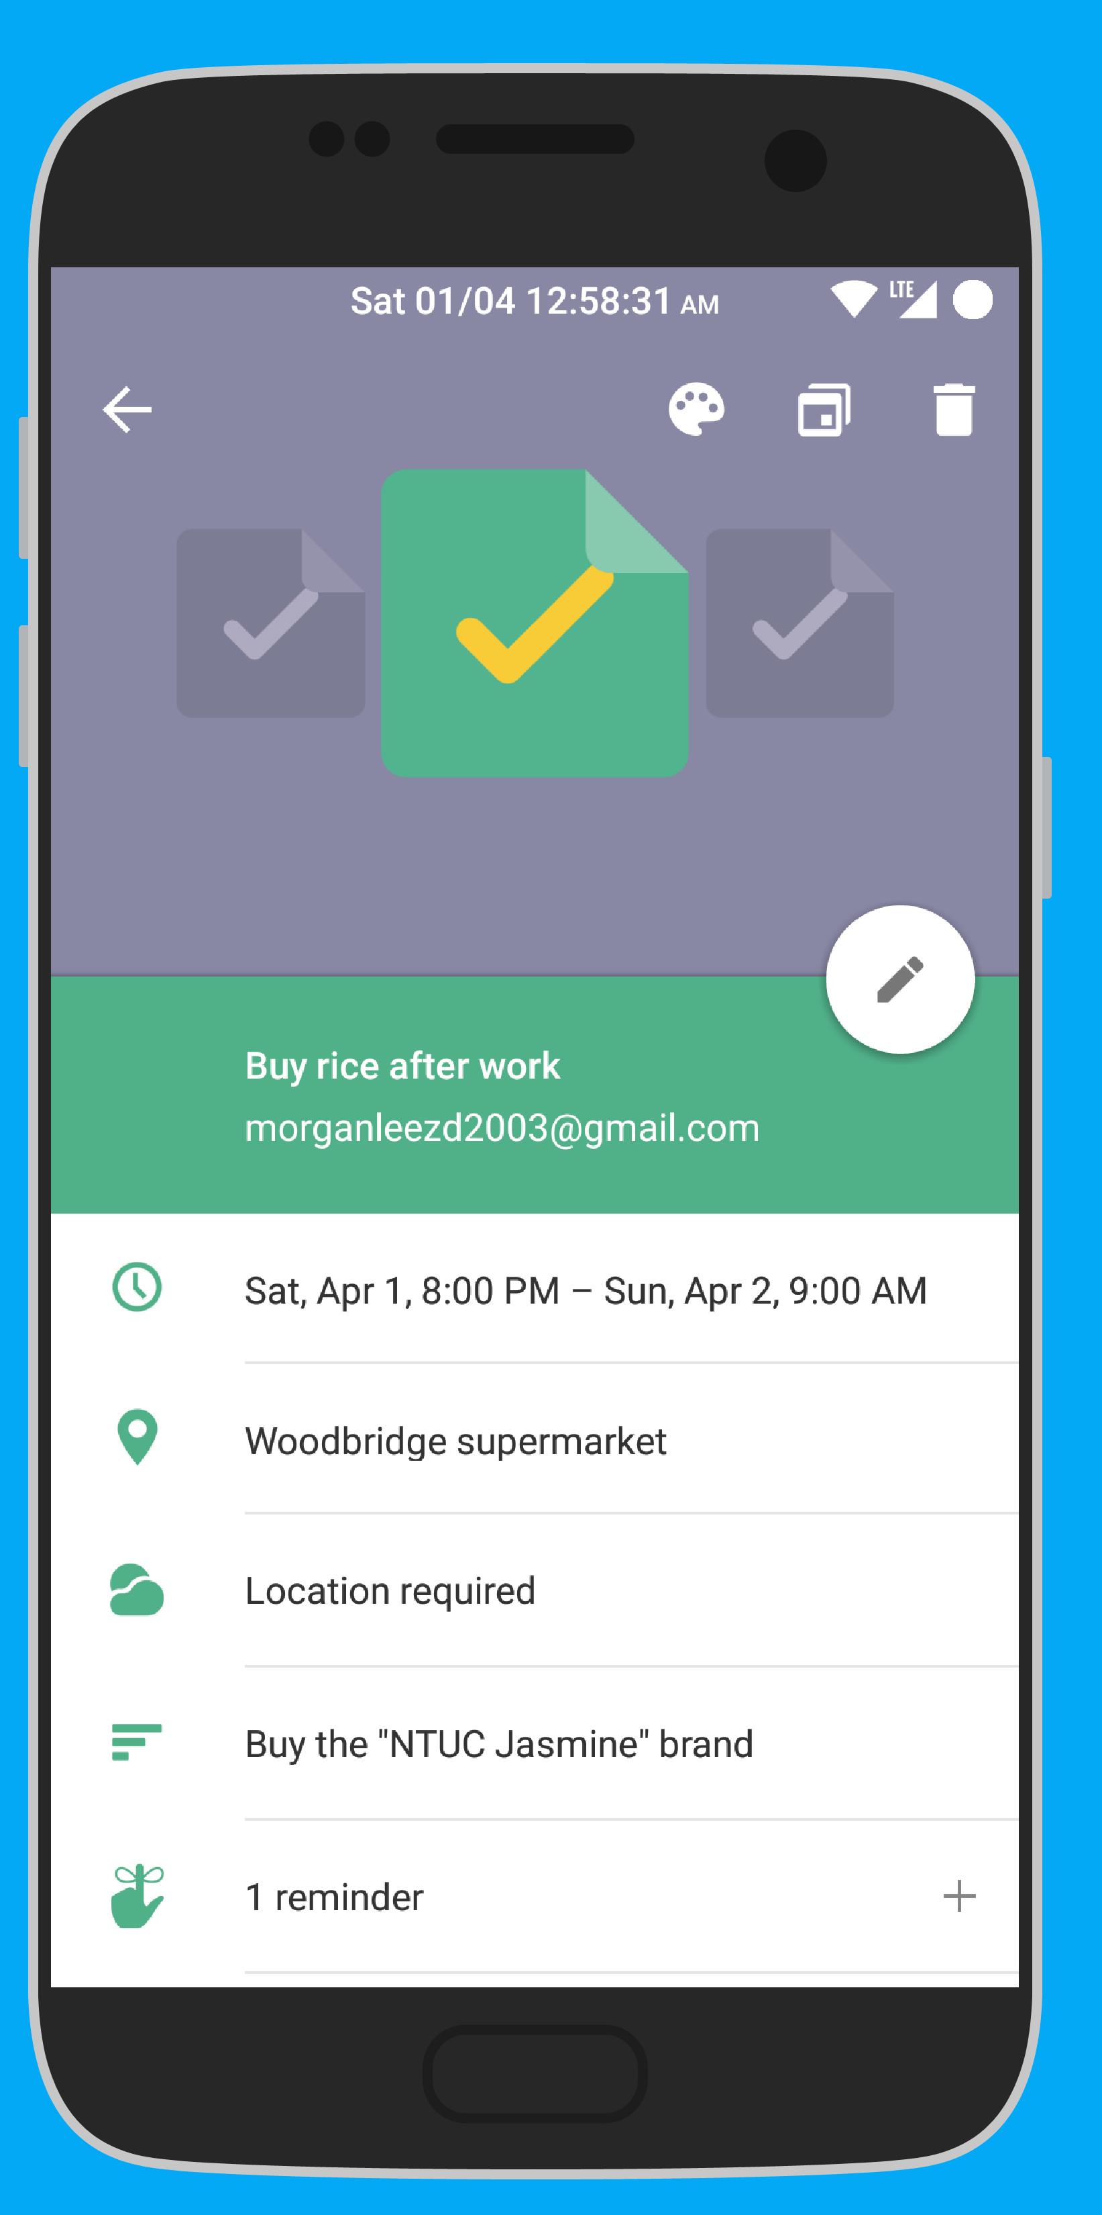
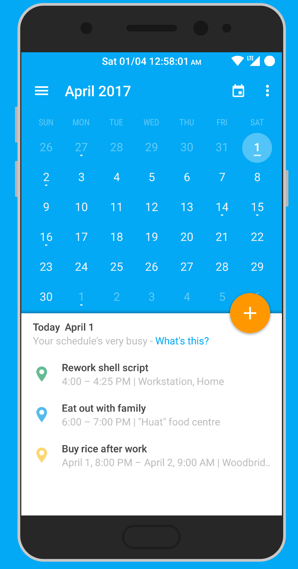
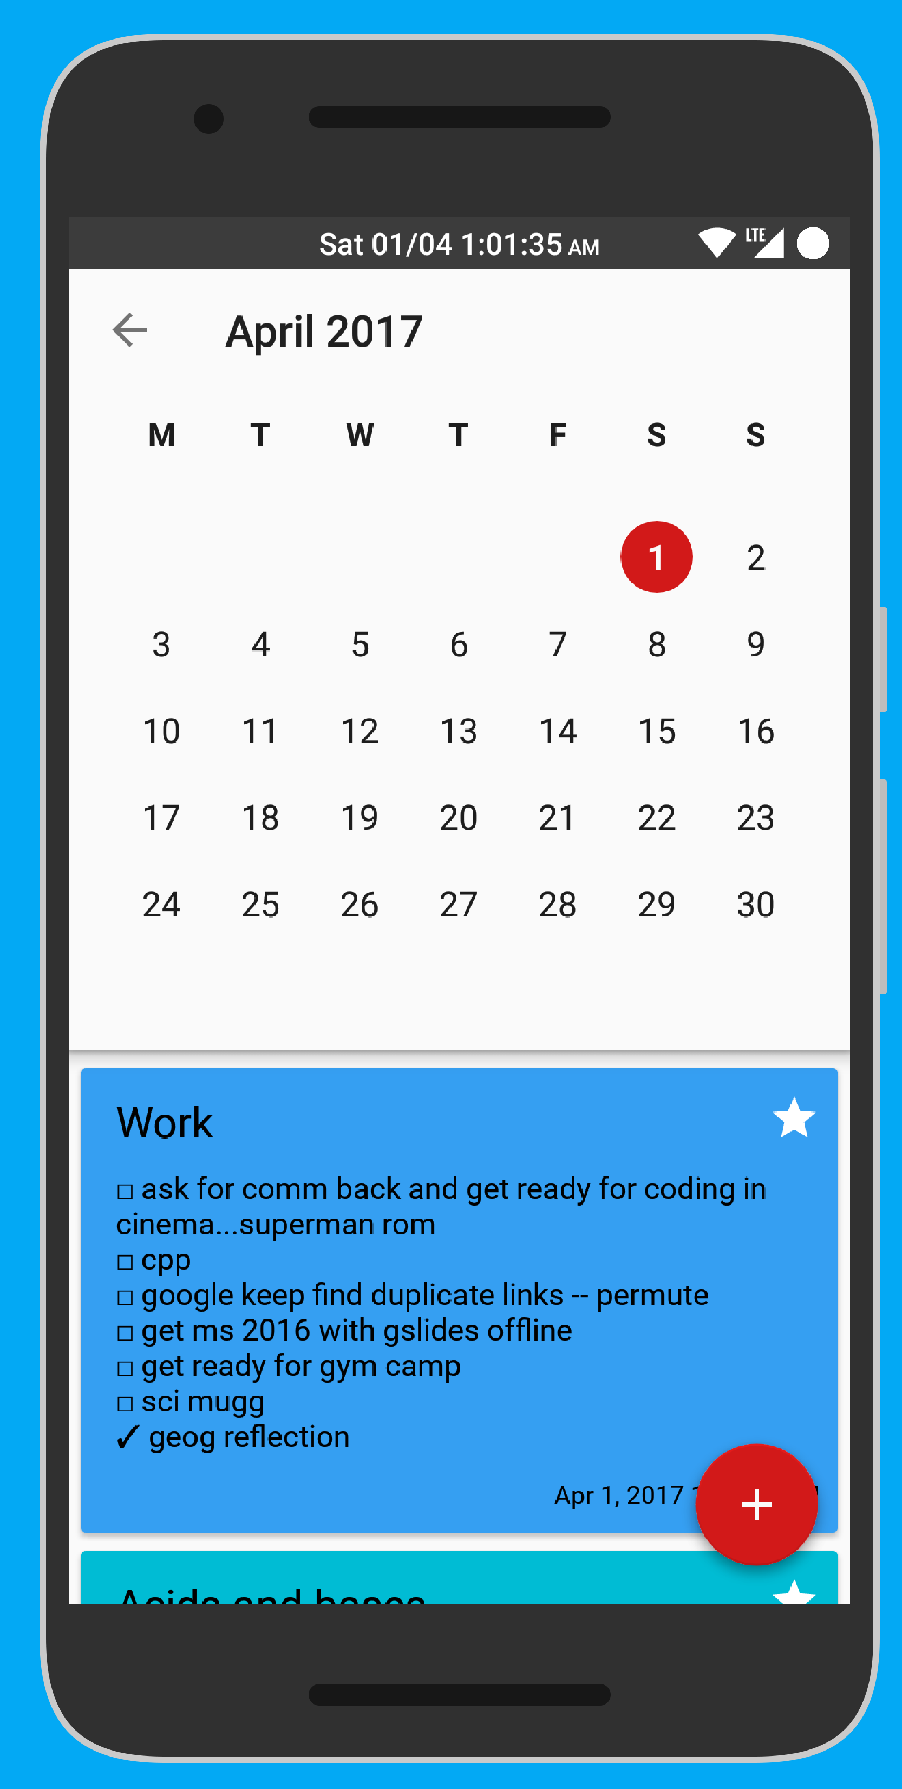

Slide 10
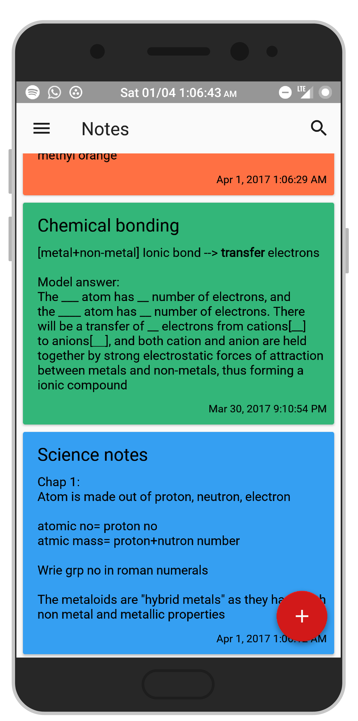
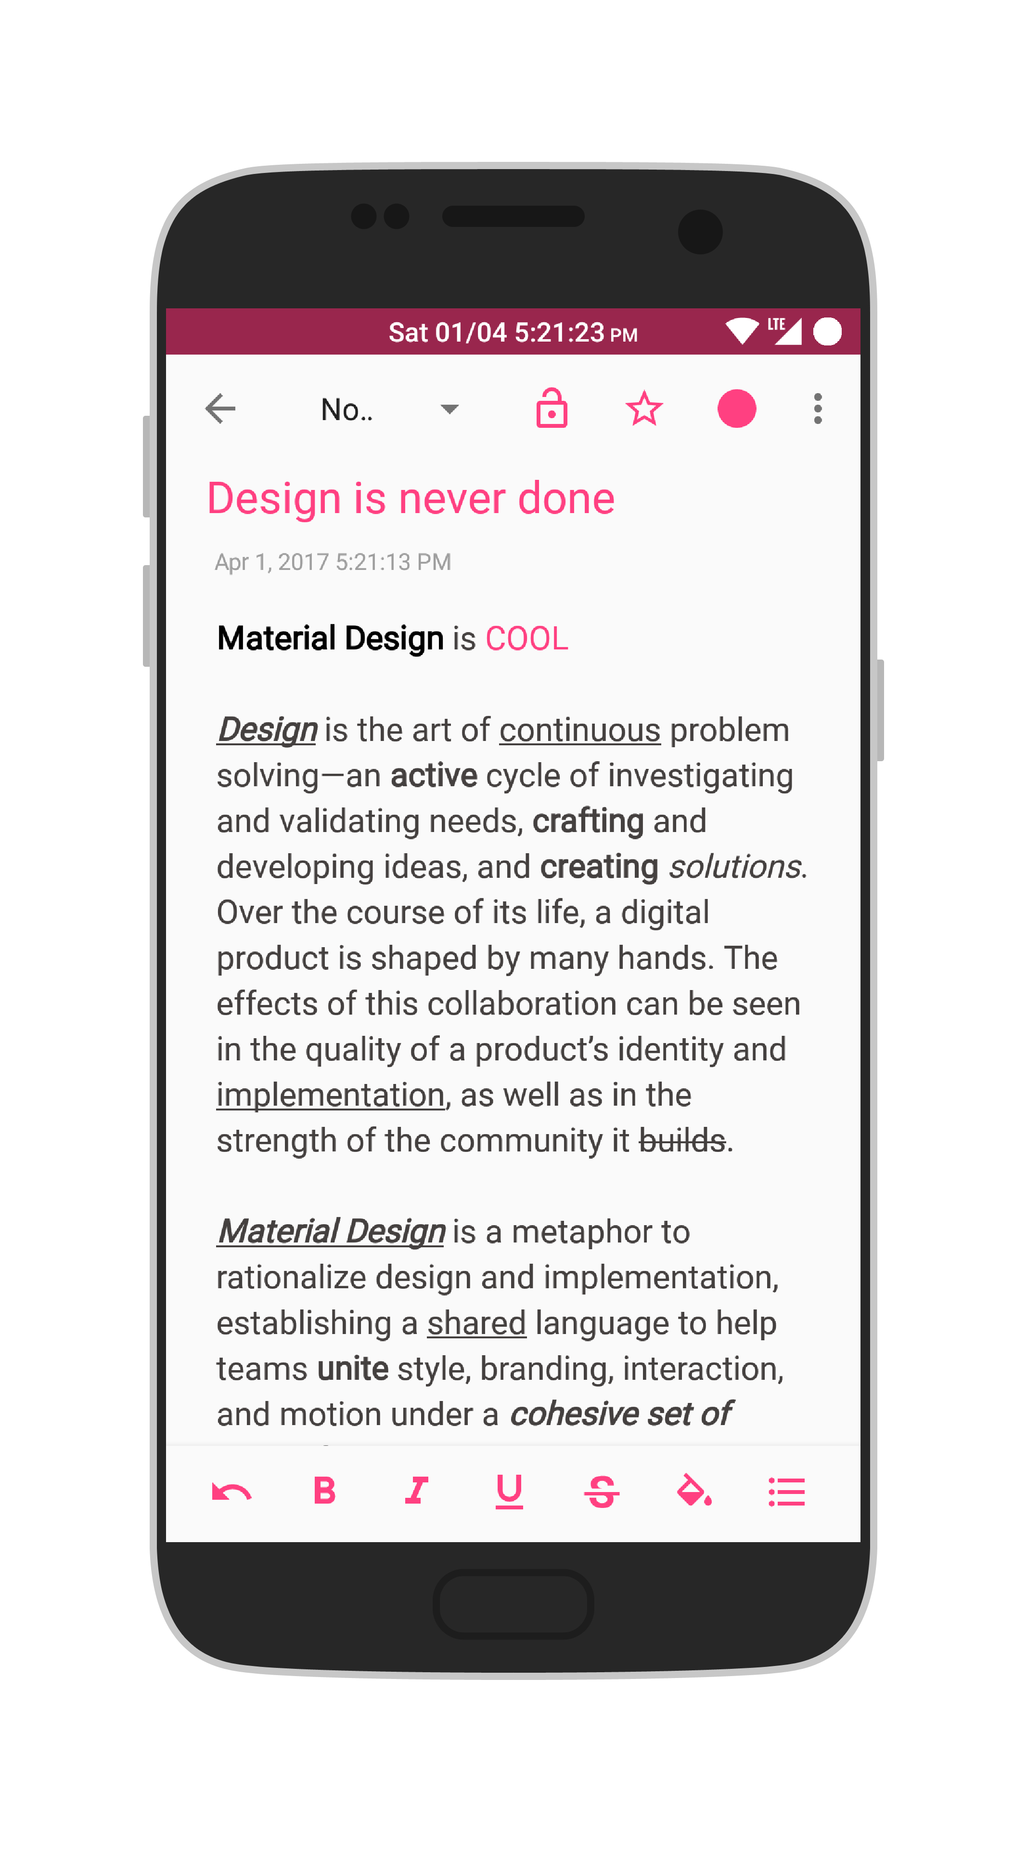
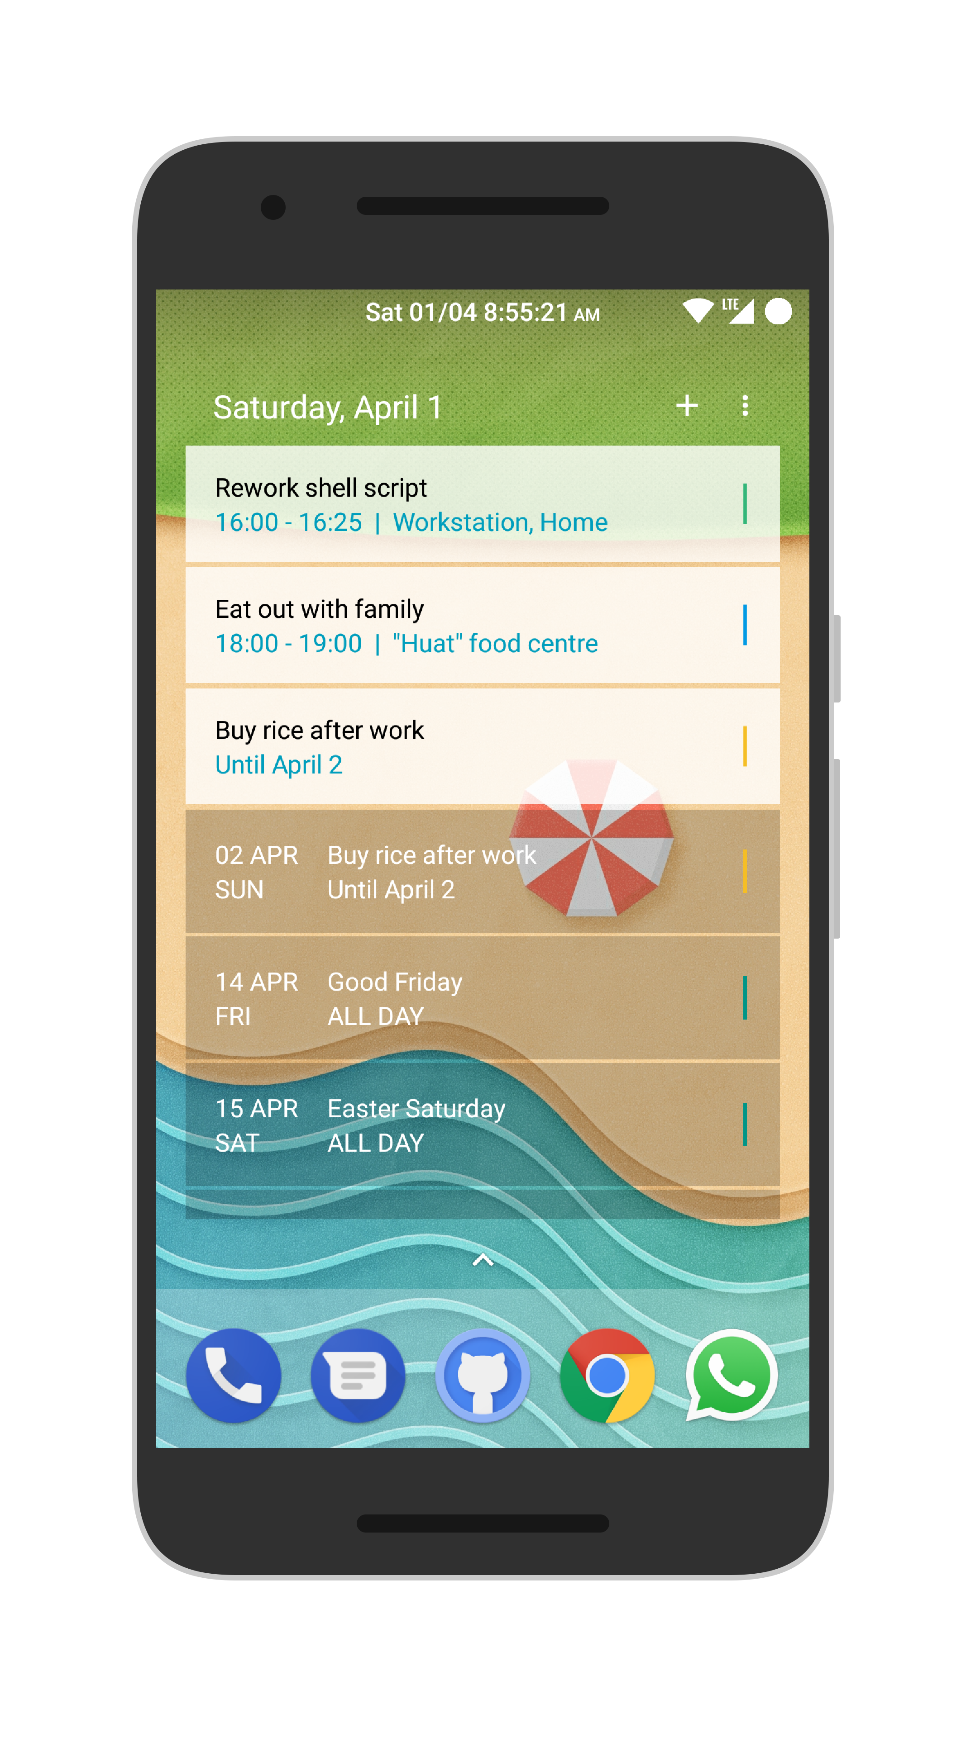

Slide 11

Methodology
Overview
Teachers input data through mobile/web platform into database, compressed and secured with a AES256 encryption algorithm. Photos are compressed by guetzil*
Data processing done client side
Students receive data, decrypt using local unique encryption keys, read metadata, allocate task into schedule using local algorithm.
This method can allow minimal load on the NGINX server. Even if the server is attacked and databases are exploited, the data will take years to decrypt, thus enforcing security. Efficiency is also prevalent, because the server is only in charge of storing and sending compressed data.

Slide 12

What’s on the market?
Timetune
A time management app that allows you to control your time exactly the way you want.
How our app is different
Schedule’s student’s homework dynamically
Seamless integration of homework into
schedule, with reminders
Restricts of non-education app

Slide 13
Timeline
5 April 2017
Proposal
evaluation
18 August 2017
Final
Evaluation
Start!
App backend code logic
Squashing bugs/ getting ready for beta phase
Initialise
Gradle dependencies
Build.gradle
Graphics, css, fonts
Framework, database
Link *.java with layout xml
Web
client
Finalise database and framework
13 July 2017
Mid-Term
Evaluation

Slide 14
Job distribution
Morgan
App developer
Designer
Benedict
Designer
App Developer
Database manager
Resource and repository organiser
Jonathan
Web Developer
Notetaker & index I/C
Material Design PPT Template
Created By: sealiu

Slide 15
Future plans
Website (HTML, CSS, PHP, Javascript, Jquery
Chrome extension (works for mac, windows, linux)
A ton of feature implemented (targeting mobile)
Material Design PPT Template
Created By: sealiu

Slide 16
References
Wei Zhen, Tan (2016, March, 16). Teens suffer when they give sleep a rest, study shows. Retrieved March 27, 2017 from http://www.straitstimes.com/singapore/health/teens-suffer-when-they-give-sleep-a-rest-study-shows
Timetune studio (2017, March, 22). Timetune- Optimise your time. Retrieved on March 31, 2017 from https://play.google.com/store/apps/details?id=com.gmail.jmartindev.timetune&hl=en
Michael Howard (2015, May, 27). Distracted by technology: Focusing Attention on Homework. Retrieved March 25, 2017 from http://www.beyondbooksmart.com/executive-functioning-strategies-blog/distracted-by-technology-focusing-attention-on-homework
The Japan News (2014, April 14) 60 per cent of kids aged 10-17 use mobile phones. Retrieved March 25, 2017, from http://news.asiaone.com/news/digital1/60-cent-kids-aged-10-17-use-mobile-phones#sthash.d30e6o3w.dpuf
Julian Gifford (2016, November, 24) Retrieved on 4 April 2017 from https://www.themuse.com/advice/the-rule-of-52-and-17-its-random-but-it-ups-your-productivity
Thank you!

Slide 17

Any
Questions

